Slide 1
Evaluation metrics in Regression

Slide 2
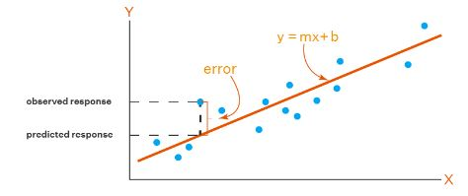
Evaluation metrics in Linear Regression
The objective of Linear Regression is to find a line that minimizes the prediction error of all the data points.
The essential step in any machine learning model is to evaluate the performance of the model.
The Mean Squared Error (MSE), Root Mean Squared Error (RMSE), Mean Absolute Error (MAE) and R-Squared are used to evaluate the performance of the model in regression analysis.

Slide 3
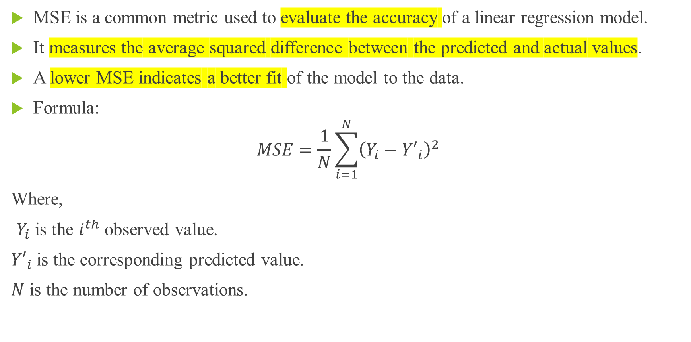
Mean Squared Error (MSE)
MSE is a common metric used to evaluate the accuracy of a linear regression model.
It measures the average squared difference between the predicted and actual values.
A lower MSE indicates a better fit of the model to the data.
Formula:
$$MSE=\frac{1}{N}\sum_{i=1}^{N}{{\left(Y_{i}−{Y′}_{i}\right)}^{2}}$$
Where,
$Y_{i}$ is the $i^{th}$ observed value.
${Y′}_{i}$is the corresponding predicted value.
$N$ is the number of observations.

Slide 4
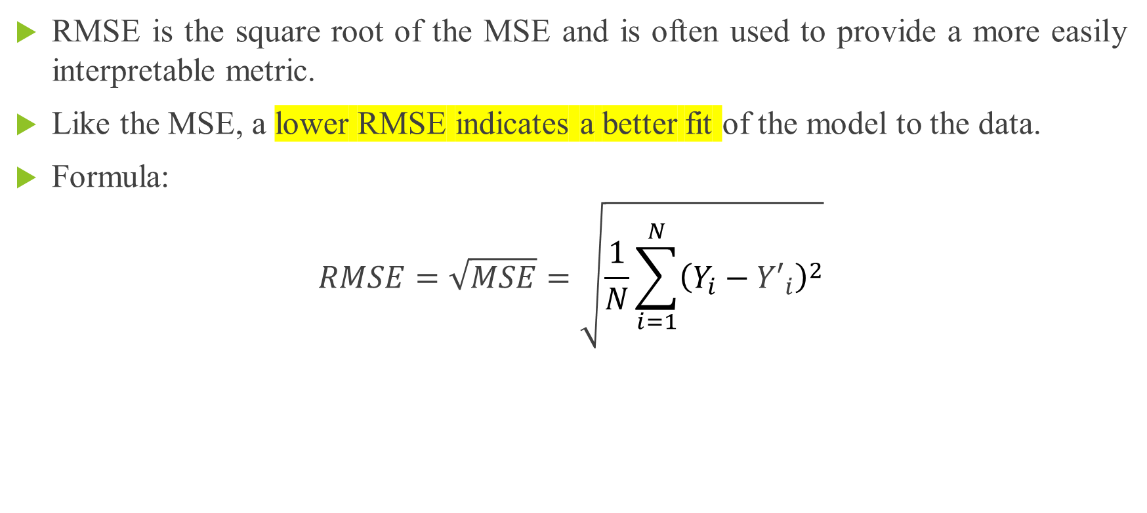
Root Mean Squared Error (RMSE)
RMSE is the square root of the MSE and is often used to provide a more easily interpretable metric.
Like the MSE, a lower RMSE indicates a better fit of the model to the data.
Formula:
$$RMSE=\sqrt{MSE}=\sqrt{\frac{1}{N}\sum_{i=1}^{N}{{\left(Y_{i}−{Y′}_{i}\right)}^{2}}}$$

Slide 5
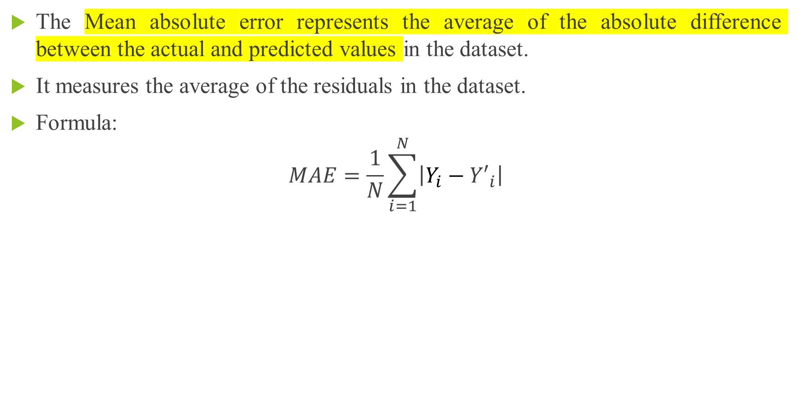
Mean Absolute Error (MAE)
The Mean absolute error represents the average of the absolute difference between the actual and predicted values in the dataset.
It measures the average of the residuals in the dataset.
Formula:
$$MAE=\frac{1}{N}\sum_{i=1}^{N}{\left|Y_{i}−{Y′}_{i}\right|}$$

Slide 6
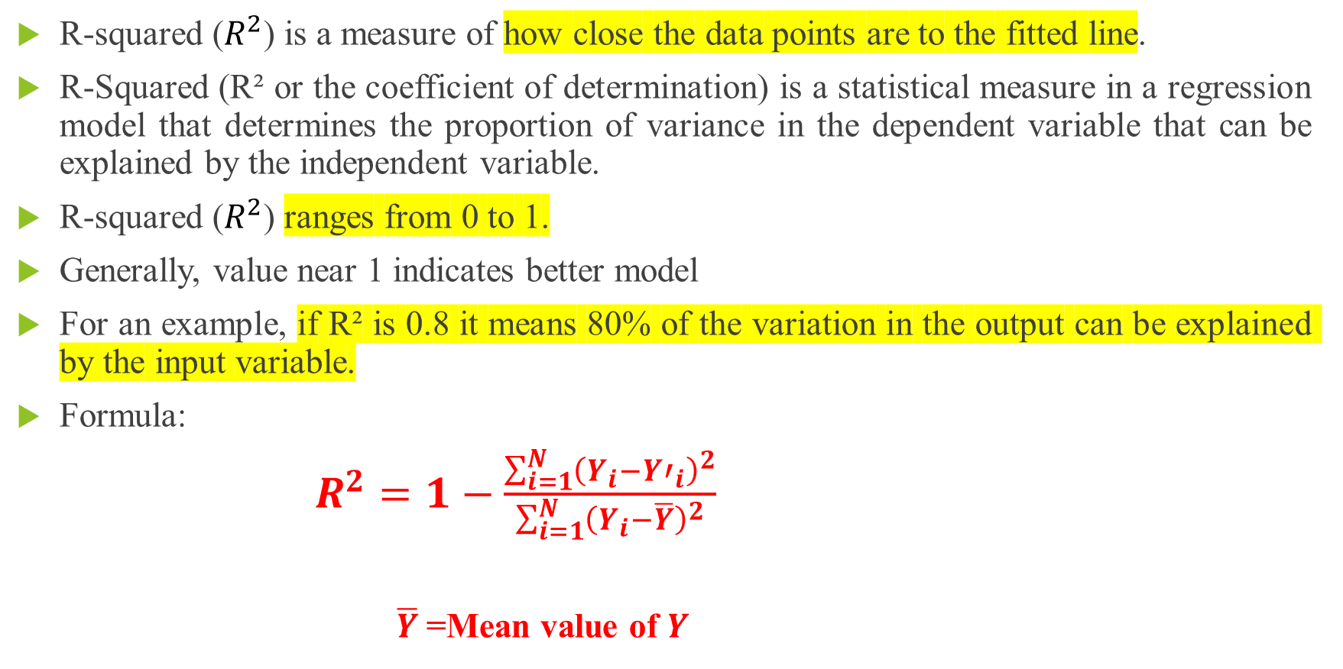
R-squared($R^{2}$)
R-squared ($R^{2}$) is a measure of how close the data points are to the fitted line.
R-Squared (R² or the coefficient of determination) is a statistical measure in a regression model that determines the proportion of variance in the dependent variable that can be explained by the independent variable.
R-squared ($R^{2}$)ranges from 0 to 1.
Generally, value near 1 indicates better model
For an example, if R² is 0.8 it means 80% of the variation in the output can be explained by the input variable.
Formula:
$R^{2}=1−\frac{\sum_{i=1}^{N}{{\left(Y_{i}−{Y′}_{i}\right)}^{2}}}{\sum_{i=1}^{N}{{\left(Y_{i}−\overline{Y}\right)}^{2}}}$
$\overline{Y}$=Mean value of $Y$

Slide 7
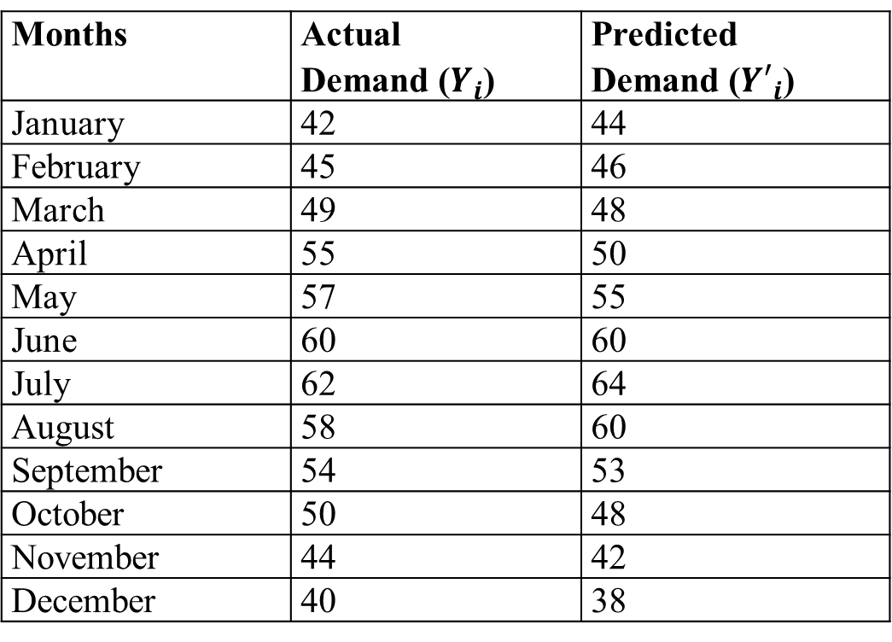
Case Study
To understand it better, let us take an example of actual demand and forecasted demand for a brand of ice creams in a shop in a year.
Months | Actual Demand ($Y_{i}$) | Predicted Demand (${Y′}_{i}$)
January | 42 | 44
February | 45 | 46
March | 49 | 48
April | 55 | 50
May | 57 | 55
June | 60 | 60
July | 62 | 64
August | 58 | 60
September | 54 | 53
October | 50 | 48
November | 44 | 42
December | 40 | 38
Continued

Slide 8
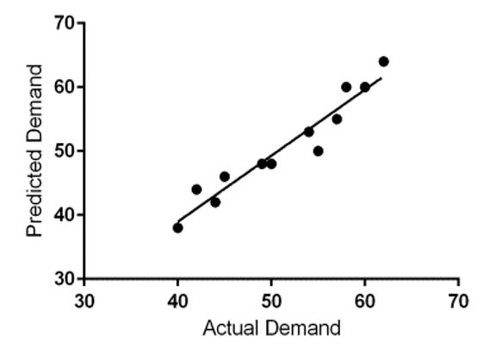
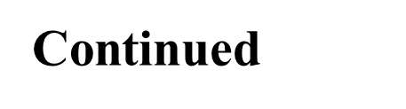
Case Study

Slide 9
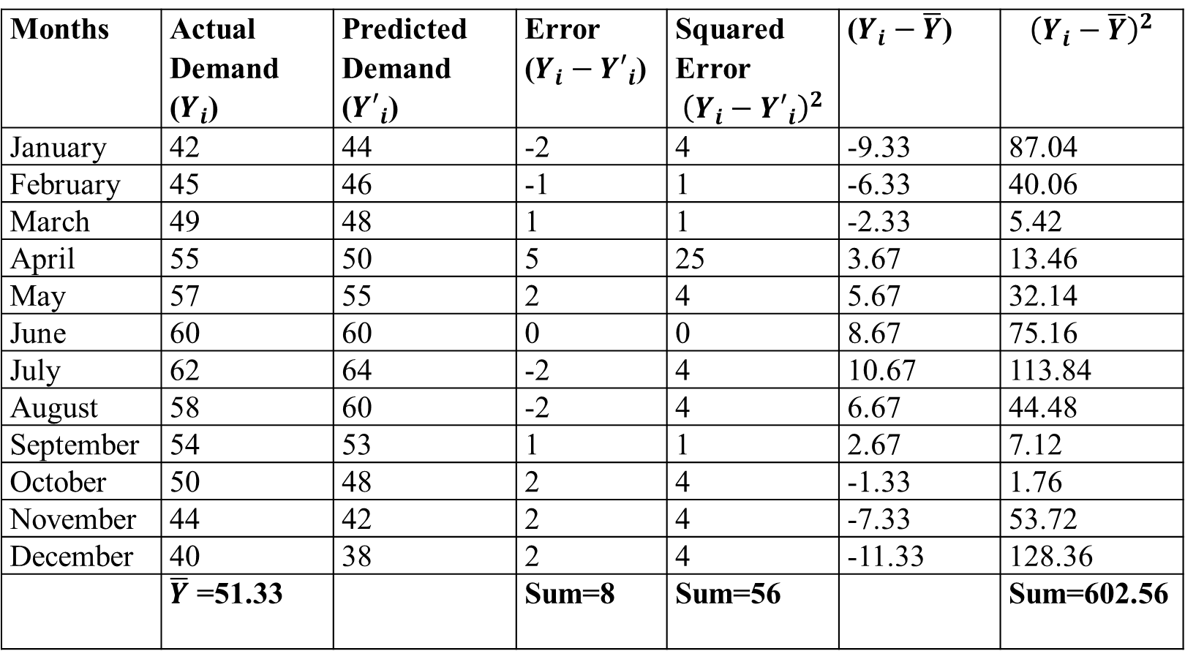
Case Study
Months | Actual Demand ($Y_{i}$) | Predicted Demand (${Y′}_{i}$) | Error ($Y_{i}−{Y′}_{i}$) | Squared Error $${\left(Y_{i}−{Y′}_{i}\right)}^{2}$$ | ($Y_{i}−\overline{Y}$) | $${\left(Y_{i}−\overline{Y}\right)}^{2}$$
January | 42 | 44 | -2 | 4 | -9.33 | 87.04
February | 45 | 46 | -1 | 1 | -6.33 | 40.06
March | 49 | 48 | 1 | 1 | -2.33 | 5.42
April | 55 | 50 | 5 | 25 | 3.67 | 13.46
May | 57 | 55 | 2 | 4 | 5.67 | 32.14
June | 60 | 60 | 0 | 0 | 8.67 | 75.16
July | 62 | 64 | -2 | 4 | 10.67 | 113.84
August | 58 | 60 | -2 | 4 | 6.67 | 44.48
September | 54 | 53 | 1 | 1 | 2.67 | 7.12
October | 50 | 48 | 2 | 4 | -1.33 | 1.76
November | 44 | 42 | 2 | 4 | -7.33 | 53.72
December | 40 | 38 | 2 | 4 | -11.33 | 128.36
 | $\overline{Y}$ =51.33 |  | Sum=8 | Sum=56 |  | Sum=602.56
Continued

Slide 10
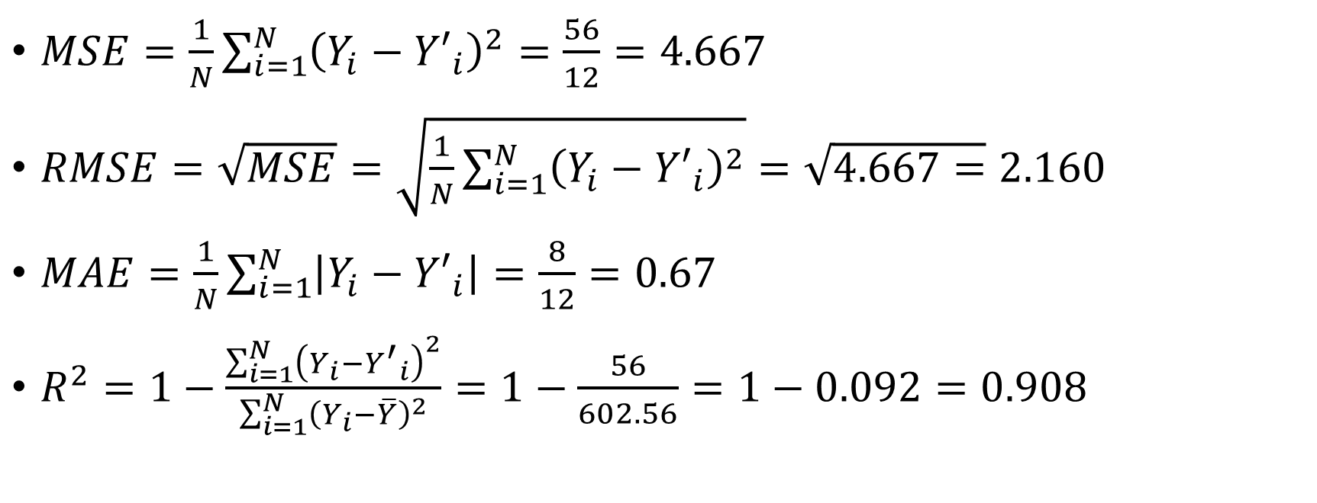
Case Study
$MSE=\frac{1}{N}\sum_{i=1}^{N}{{\left(Y_{i}−{Y′}_{i}\right)}^{2}}=\frac{56}{12}=4.667$
$RMSE=\sqrt{MSE}=\sqrt{\frac{1}{N}\sum_{i=1}^{N}{{\left(Y_{i}−{Y′}_{i}\right)}^{2}}}=\sqrt{4.667=}2.160$
$MAE=\frac{1}{N}\sum_{i=1}^{N}{\left|Y_{i}−{Y′}_{i}\right|}=\frac{8}{12}=0.67$
$R^{2}=1−\frac{\sum_{i=1}^{N}{{\left(Y_{i}−{Y^{′}}_{i}\right)}^{2}}}{\sum_{i=1}^{N}{{\left(Y_{i}−\overline{Y}\right)}^{2}}}=1−\frac{56}{602.56}=1−0.092=0.908$

Slide 11
References
1.Tom M. Mitchell, “Machine Learning ”, McGraw Hill Education, Indian Edition, 9781259096952.
2.Anuradha Srinivasaraghavan and Vincy Joseph, “Machine Learning” Wiley, 8126578513.
3.https://www.studytonight.com/post/what-is-mean-squared-error-mean absolute-error-root-mean-squared-error-and-r-squared
4.https://vitalflux.com/r-squared-explained-machine-learning/

Slide 12
Thank You

